Slide 1
Digital Image Processing Lecture - 4
Course Teacher:
Md. Rayhan Ahmed
Rayhan@cse.uiu.ac.bd

Slide 2
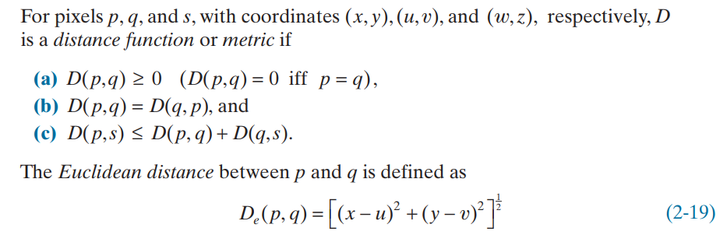
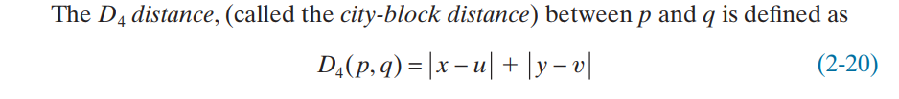
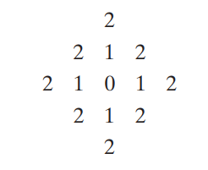
DISTANCE MEASURES BETWEEN PIXELS
For example, the pixels with D4 distance ≤ 2 from (x,y) (the center point) form the following contours of constant distance:

Slide 3
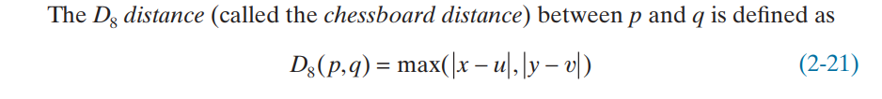
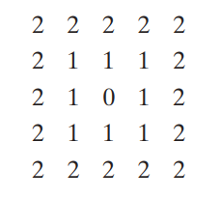
DISTANCE MEASURES BETWEEN PIXELS
For example, the pixels with D8 distance ≤ 2 form the following contours of constant distance:

Slide 4
DISTANCE MEASURES BETWEEN PIXELS
Note that the D4 and D8 distances between p and q are independent of any paths that might exist between these points because these distances involve only the coordinates of the points.
In the case of m-adjacency, however, the Dm distance between two points is defined as the shortest m-path between the points. In this case, the distance between two pixels will depend on the values of the pixels along the path, as well as the values of their neighbors.
Question: An image segment is shown below: Let V be the set of gray level values used to define connectivity in the image. Compute D4, D8, and Dm distances between pixels p and q for:
V={2,3}
V={2,6}
Here, p (x,y)=(0,0)and q (s,t)=(4,4)
Solution: D4 = 8, D8= 4
Solution: Dm, V={2,3} = no path, q(6) is not included in V
Solution: Dm, V={2,6} = no path between p and q.
2(p) | 3 | 2 | 6 | 1
6 | 2 | 3 | 6 | 2
5 | 3 | 2 | 3 | 5
2 | 4 | 3 | 5 | 2
4 | 5 | 2 | 3 | 6(q)

Slide 5
DISTANCE MEASURES BETWEEN PIXELS
Another Question: An image segment is shown below: Let V be the set of gray level values used to define connectivity in the image. Compute D4, D8, and Dm distances between pixels p and q for:
V={0,1}
V={1,2}
Here, p (x,y)=(0,0)and q (s,t)=(3,3)
Solution: D4 = 6, D8= 3
Solution: Dm, V={0,1} = 5
Solution: Dm, V={1,2} = 6
3 | 1 | 2 | 1(q)
0 | 2 | 0 | 2
1 | 2 | 1 | 1
1(p) | 0 | 1 | 2

Slide 6
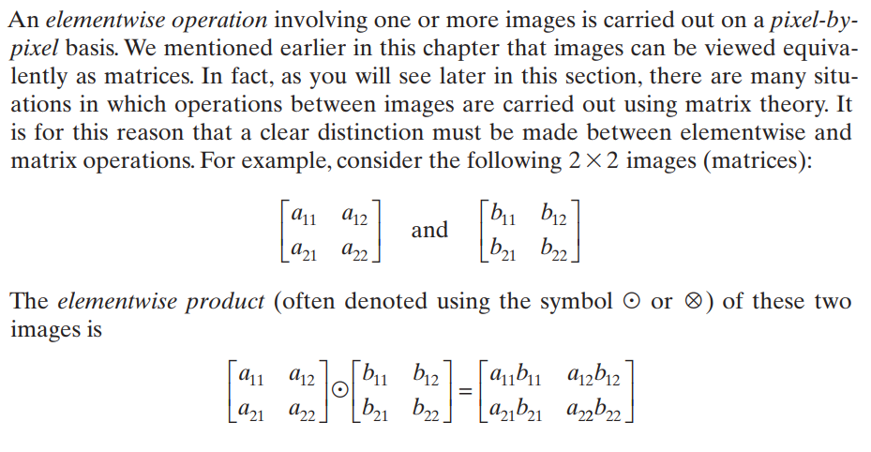
ELEMENTWISE VERSUS MATRIX OPERATIONS

Slide 7
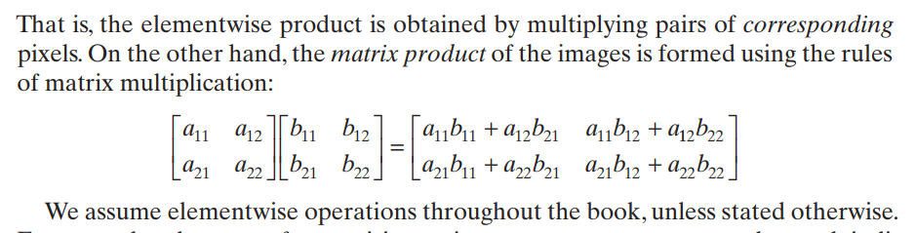
ELEMENTWISE VERSUS MATRIX OPERATIONS

Slide 8
Basic Image Intensity Transformations Point Operations
Digital Negative
Thresholding
Clipping
Bit-Plane Slicing
Material: Hand Notes + Book

Slide 9
Basic Image Intensity Transformations Histogram Equalization
Material: Hand Notes + Book

Slide 10
Basic Image Intensity Transformations Contrast Enhancement
Material: Hand Notes + Book

